Slide 1
An Introduction to the Multichannel Rendezvous Problem-Part V
Prof. Cheng-Shang Chang (張正尚教授)
Institute of Communications Engineering National Tsing Hua University
July 2025

Slide 2
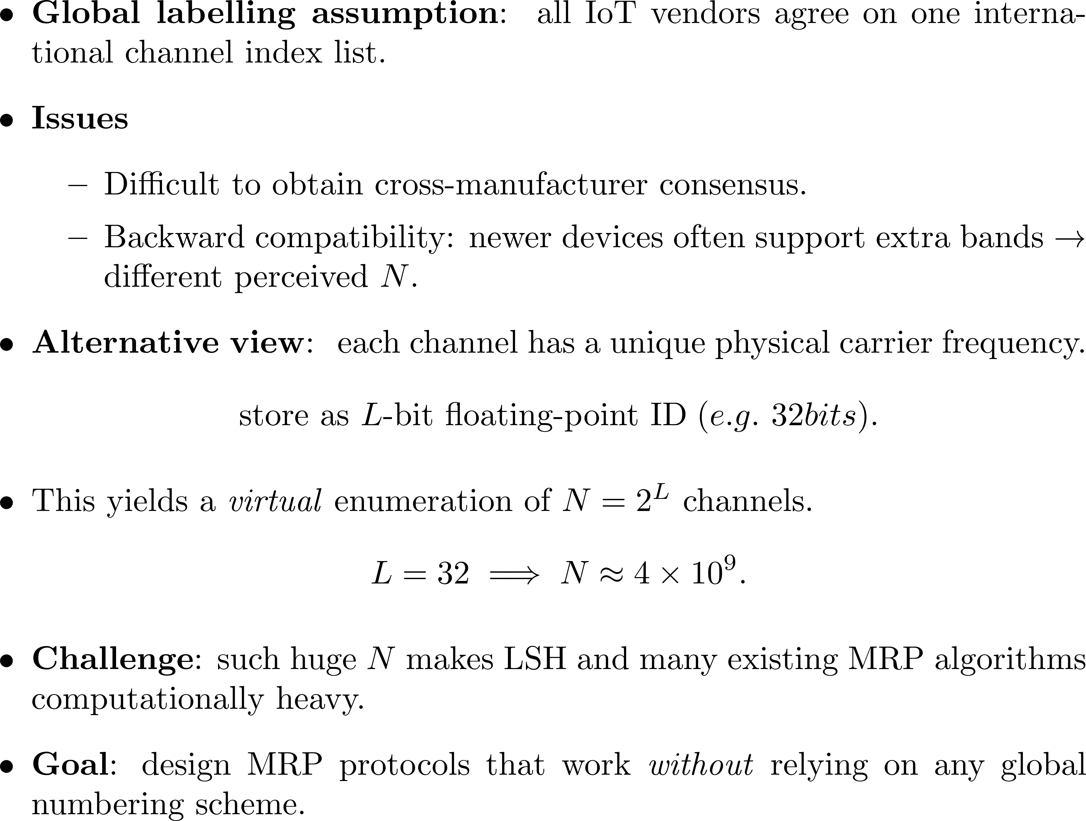

Slide 3
The sym/async/hetero/ID MRP
The two users are indistinguishable.
Their clocks may not be synchronized.
Their available channel sets may differ.
Each user's channel labels are uniquely identified by an L-bit ID.
Y. -C. Cheng and C. -S. Chang, "On the Multichannel Rendezvous Problem without Global Channel Enumeration," 2024 33rd Wireless and Optical Communications Conference (WOCC), Hsinchu, Taiwan, 2024, pp. 30-34.

Slide 4
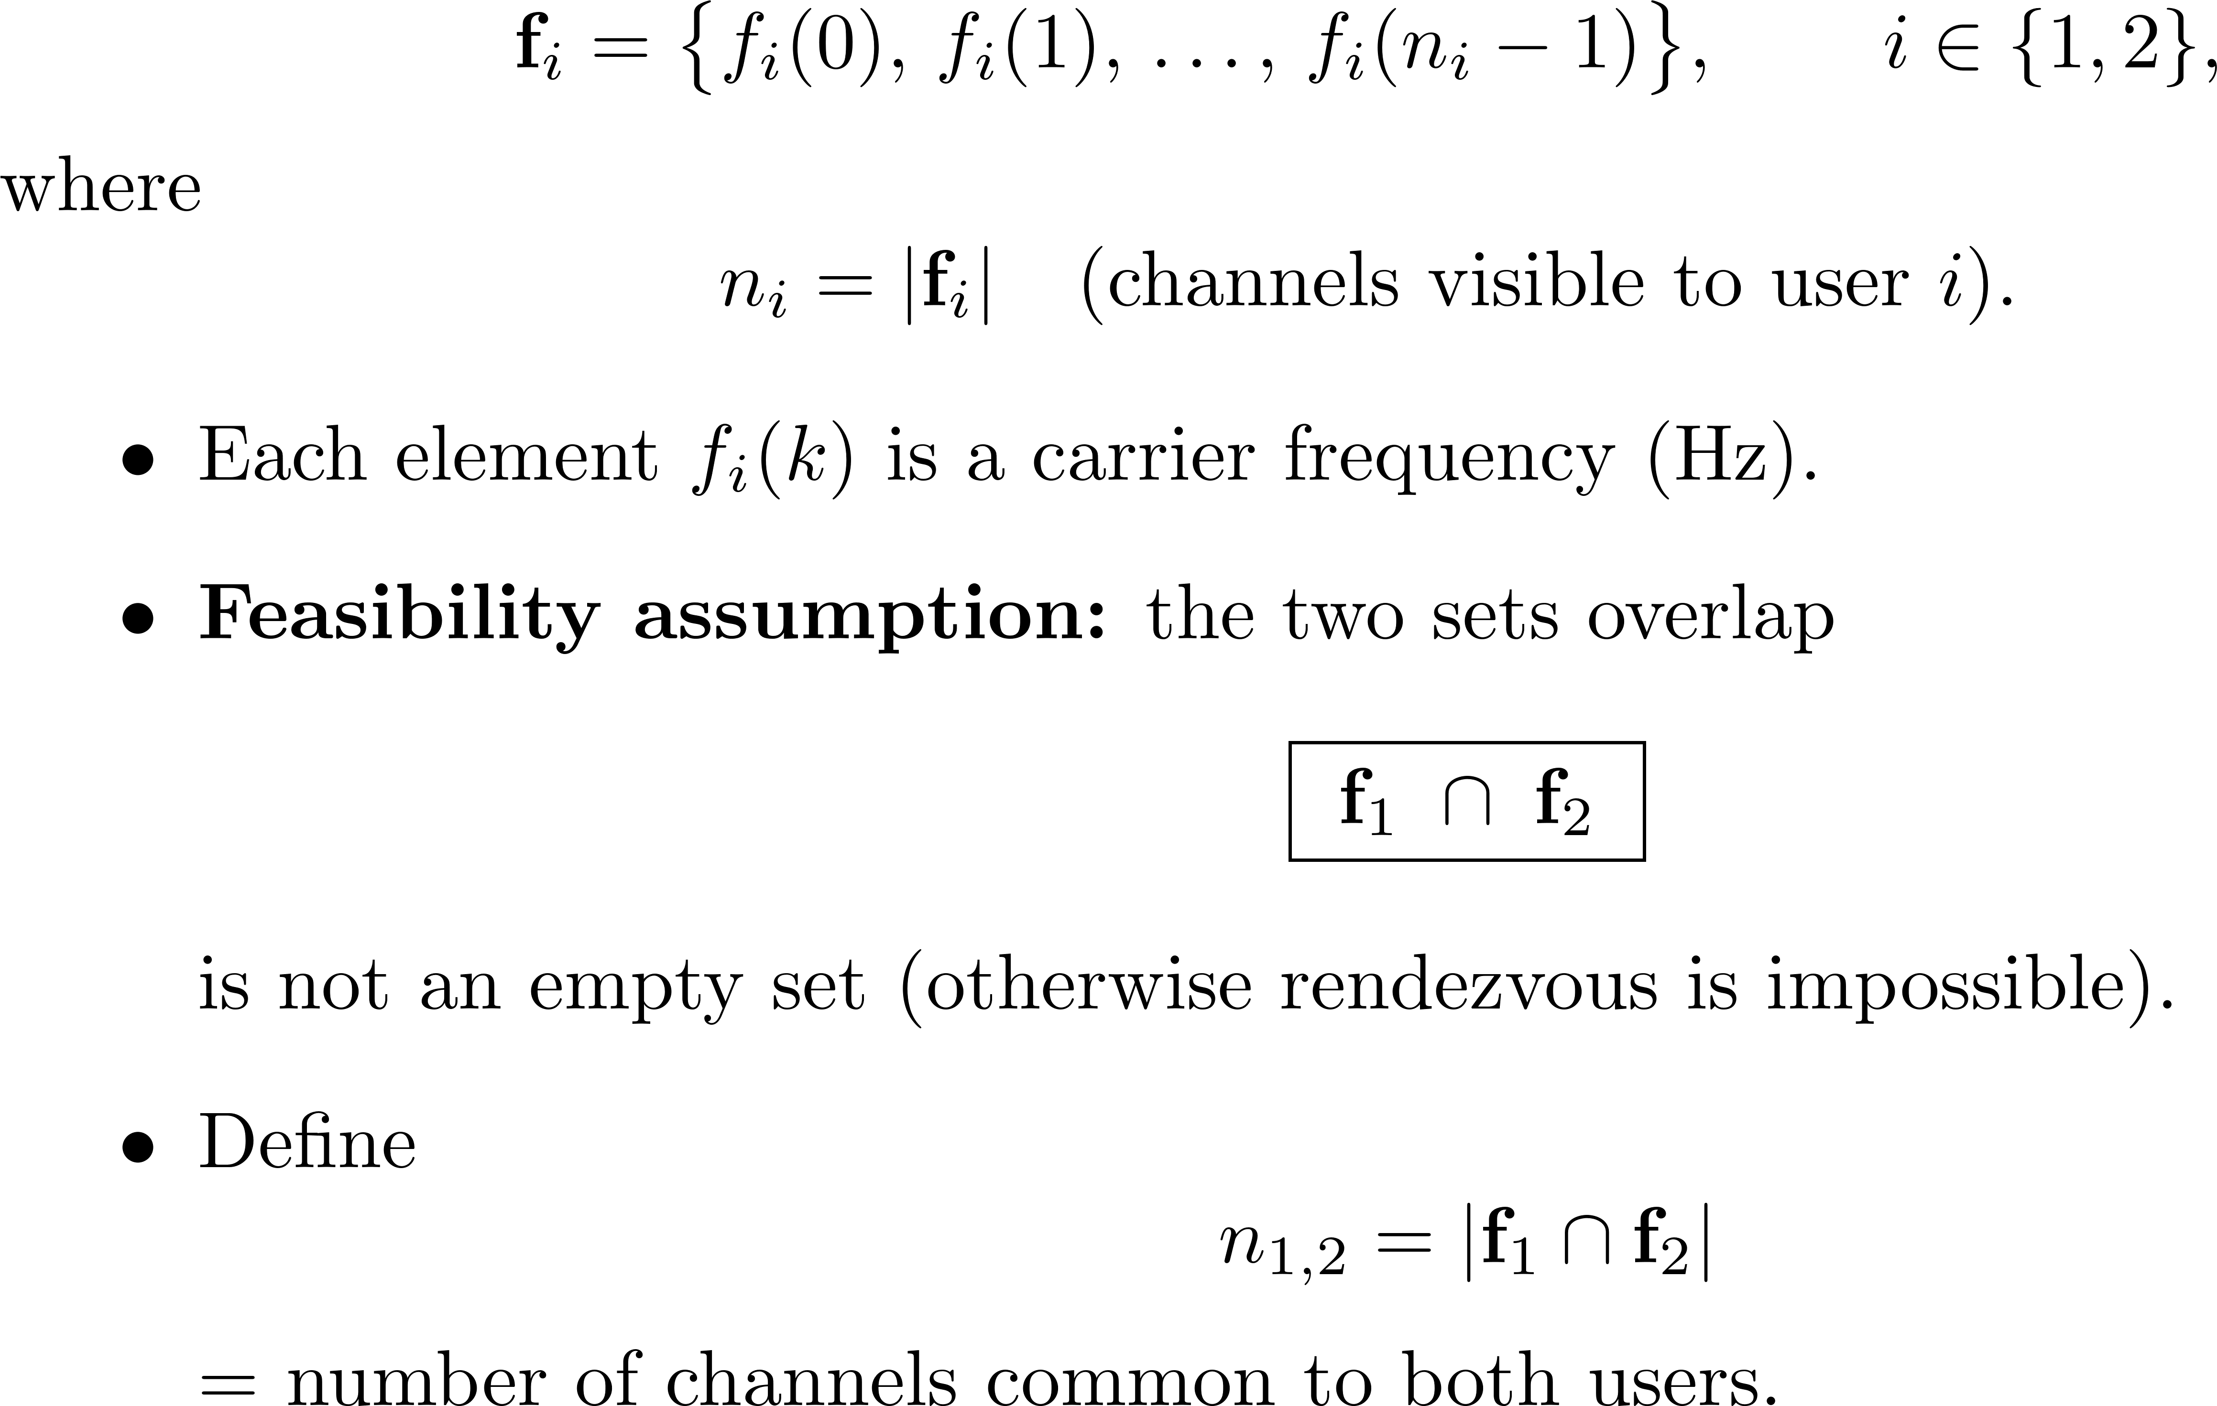
Available Channel Sets

Slide 5

Motivation
Address the challenge of the MRP without a global channel enumeration system
However, most of the algorithms in the existing literature cannot handle such a large N
Compatibility
Problem
Without global channel enumeration system
Channels (frequencies) are labeled as unique identifiers (IDs), such as single-precision floating point numbers
With global channel enumeration system
Channels are globally labeled from 1 to N, where N is the total number of channels
32-bit ID
sym/sync/hetero/global
sym/async/hetero/global
sym/sync/hetero/ID
sym/async/hetero/ID
Notes:
前面有提到global channel enumeration system指的是channel會從1到N被globally labeled
但因為新一代的IoT device可能可以用的channel總數更多，導致相容性問題，因為兩個世代對channel總數的觀點可能不同
更具體的說，channel label的設定會變成ID
所以我們的研究動機是想要解決MRP在沒有global channel enumeration system下的挑戰
我們假設每一個channel都有一個unique frequency，用L-bit ID來表示
舉例來說，假如channel的frequency是用single-precision floating point numbers with 4 bytes來表示，那每一個frequency就會有32-bit ID
那當然我們可以把32-bit ID轉成integer，得到2的32次方個channel
但大部分的演算法沒有辦法處理那麼大的channel總數
-
As mentioned before, one common assumption made in the literature for the MRP is that there is a global channel enumeration system. However, a new generation of IoT devices might be capable of using more channels than those in the previous generation, leading to a compatibility problem because two different generations might have different views of the total number of channels.
To be more specific, the setting of channel labels will appear to be 'local.’
Therefore, our first motivation is to address the challenge of the MRP without a global channel enumeration system. We assume that each channel is associated with a unique frequency and can be represented by an L-bit ID. For example, if the frequency of a channel is represented by a single-precision floating-point number with 4 bytes, then there is a 32-bit ID for each frequency.
Certainly, we can convert the 32-bit ID into an integer and obtain a global channel enumeration system with 2 to the power of 32 channels.
However, most of the algorithms in the existing literature cannot handle such a large N.

Slide 6
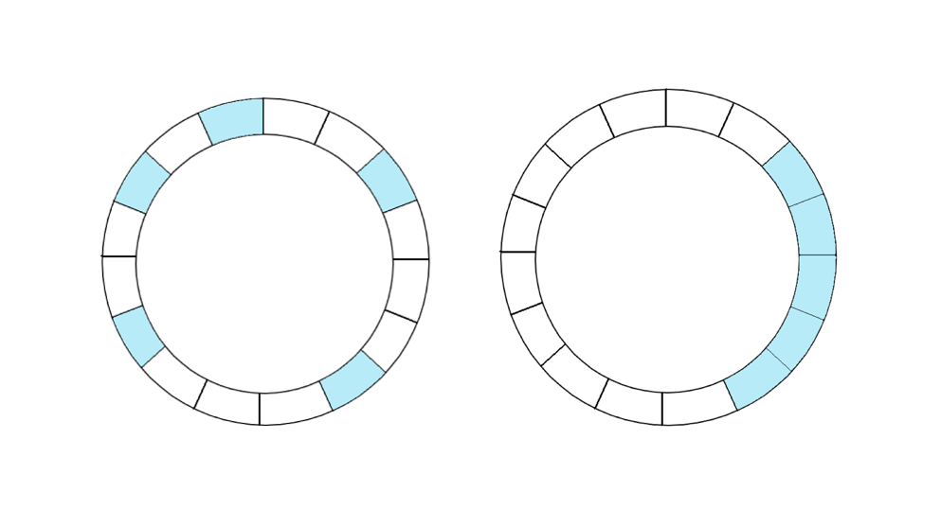
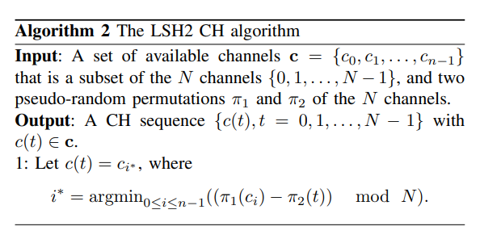
Motivation
LSH2 needs to implement two pseudo-permutations.
Bad example
Evenly
distributed
remap
Notes:
但LSH會有兩個缺點，所以後來提出了LSH2
第一個缺點是如果available channel像上面的左邊那張圖一樣是連續的，每個channel被選到的機率就會不一樣。所以LSH2加了一個pseudo-random permutation pi1，讓channel可以高機率的均勻分布
那LSH的第二個缺點是MTTR沒辦法被bound住，因為它可能會一直選到無法交會的channel。所以LSH2改用sampling without replacement，加了一個pseudo-random permutation pi2

Slide 7
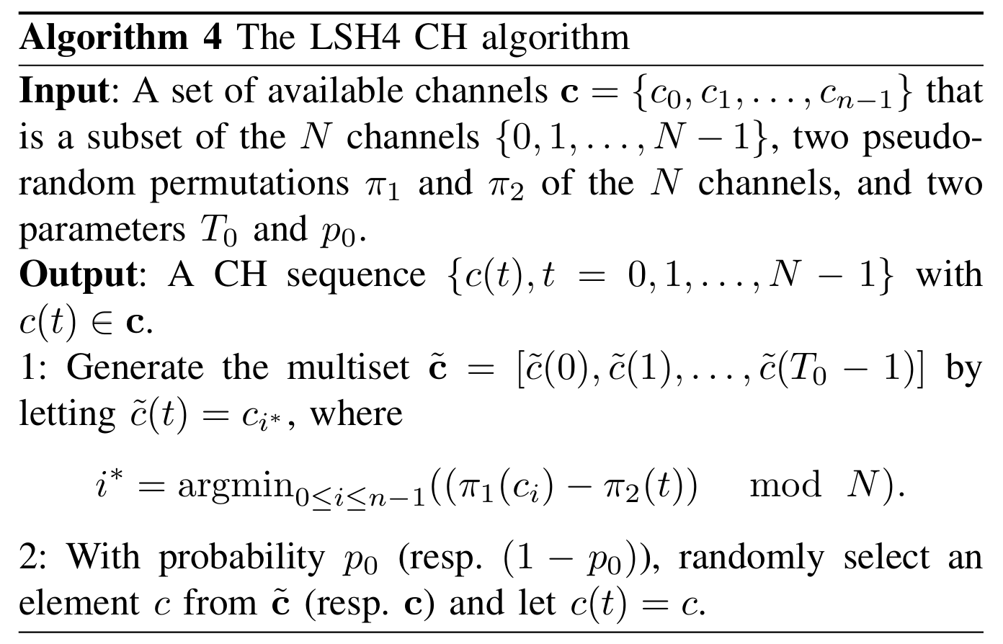
Motivation
LSH4
Implementing a random permutation of channels is extremely difficult in an IoT device.
→ Reduce the implementation complexity
LSH2
Notes:
另一方面，在非同步設定下，他們提出了LSH4演算法
主要是先用LSH2產生一個multiset，後面有p0的機率從multiset隨機挑channel，1-p0的機率從available channel set隨機挑channel
但對於N很大的時候，pseudo-random permutation會導致計算成本很高
所以我們希望想辦法減少implementation complexity

Slide 8
Consistent Hashing (CHash)
Hash server (with multiple virtual servers for load balancing)
Then hash URL
Closest match
Only local mapping changes after adding or removing servers
Used by State-of-the-art CDNs and datacenters
url-0
svr1
svrN
svr0
svr1
url-1
svr2
D. Karger, E. Lehman, T. Leighton, M. Levine, D. Lewin, and R. Panigrahy, ``Consistent hashing and random trees: Distributed caching protocols for relieving hot spots on the
world wide web,'' Proceedings of the Twenty-ninth Annual ACM Symposium on Theory of Computing (STOC), pp. 654--663, 1997.
svr0
Unit circle
Notes:
Don’t talk too much detail
If don’t stop at the closest server, it provides the order of accessing set of servers.

Slide 9
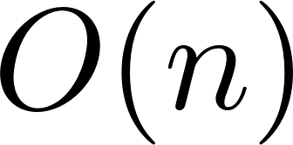
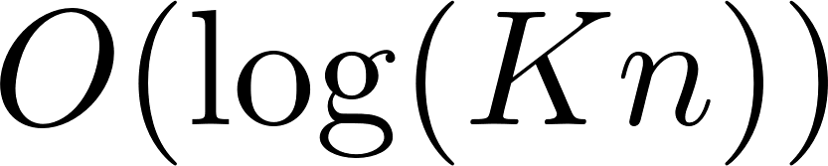

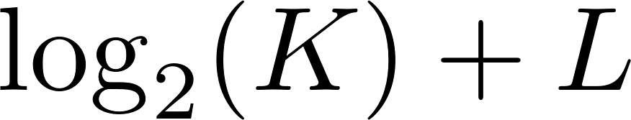
Main contribution (1/2)
Propose low-complexity implementations of the LSH algorithms so that LSH can be used for the MRP without a global channel enumeration system.
  Online computational complexity
    Channel selection: →
  Offline computational complexity:
    Implementing a random permutation of elements to a random permutation of elements.
Notes:
這篇論文提出了低複雜度的LSH演算法，可以解決沒有global channel enumeration system的多通道交會問題
Online的計算複雜度，channel selection可以從linear search降到binary search
Offline的計算複雜度，可以從需要使用2的L次方個random permutation，降到只需要用到~個random permutation
-
Our main contribution is that we propose low-complexity implementations of the LSH algorithms so that LSH can be used for the MRP without a global channel enumeration system.
We map each frequency into the enlarged hash space K times, which means that each frequency is represented by K virtual frequencies. According to the law of large numbers, when K is large, the intervals associated with available channels are expected to be evenly spaced. This variance reduction trick is widely used for load-balanced consistent hashing in modern data centers and peer-to-peer networks.

Slide 10
Main contribution (2/2)
Instead of using a random permutation to re-distribute the N channels, we use a variance reduction trick of load-balanced consistent hashing.
  Each frequency is represented by K virtual frequencies.
  When K is large, it is expected from the law of large numbers that the intervals associated with available channels are nearly evenly spaced.
Address the challenge of achieving a bounded MTTR.
Notes:
我們使用了consistent hashing裡的variance reduction trick，也就是把每個frequency用K個virtual frequency來表示
根據大數法則，當K很大的時候，我們預期available channel的區間會接近均勻分布
最後，我們做到了演算法是可以有bounded MTTR的

Slide 11
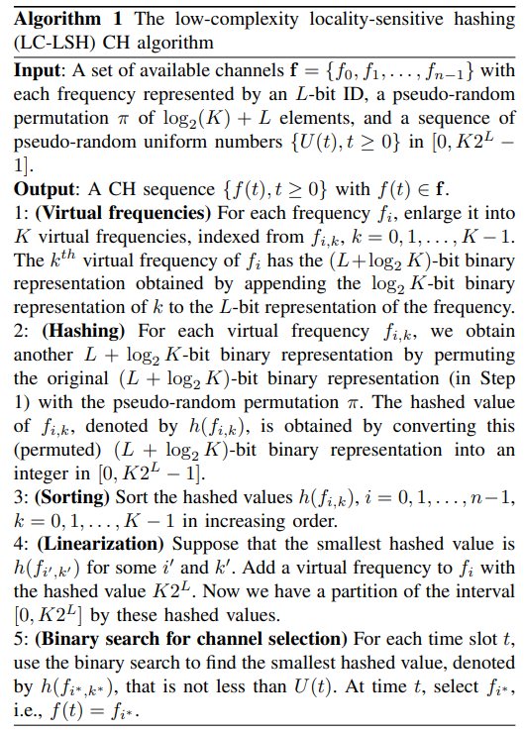
The synchronous setting
LC-LSH
  1. Virtual frequencies (maintain uniqueness)
  2. Hashing (low complexity)
  3. Sorting
  4. Linearization
  5. Binary Search for channel
  selection
Notes:
在同步設定下，我們提出了右邊的LC-LSH演算法
它主要有五個步驟，分別是~
-
The algorithm on the right is the LC-LSH algorithm for the synchronous setting. It consists of five steps: virtual frequencies, hashing, sorting, linearization, and binary search for channel selection. I will now show you an example by using the slide animation.

Slide 12












The synchronous setting (2/4)
1. Virtual frequencies
Notes:
這裡我們舉一個例子來說明每個步驟
假設有個user有3個用7-bit來表示的frequency
首先，我們選K=2，然後把每個frequency map到2個用8-bit表示的virtual frequency
-
Consider a user with three frequencies that have 7-bit binary representations. First, suppose we choose K=2 and map each frequency to two virtual frequencies, resulting in 8-bit binary representations.

Slide 13

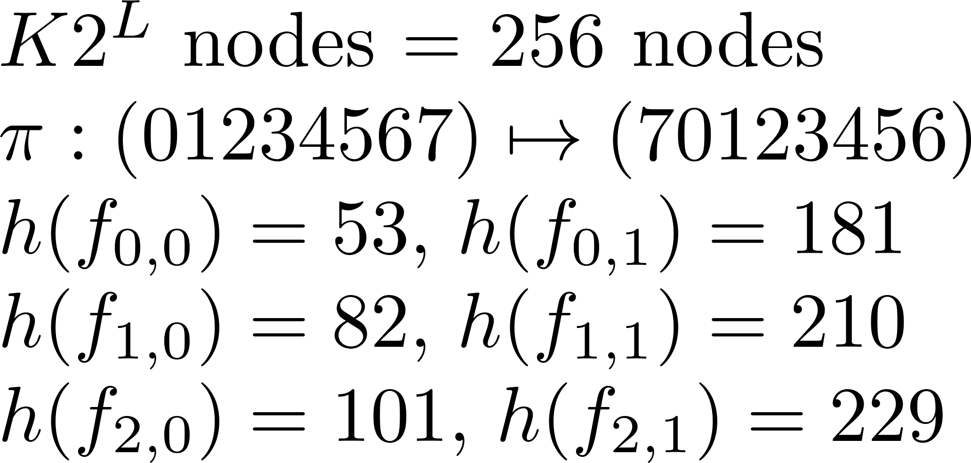







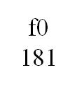

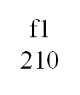
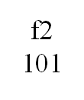
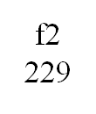
The synchronous setting (3/4)
2. Hashing
Notes:
接著我們用一個random permutation pi，把每個virtual frequency hash到一個ring上
-
Then, we use a random permutation π to hash each virtual frequency into a ring with 256 nodes and obtain a ring like the figure on the right side.

Slide 14
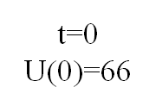
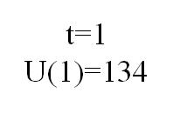
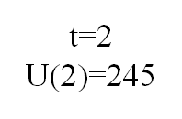
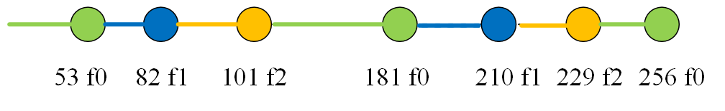
The synchronous setting (4/4)
3. Sorting
4. Linearization
5. Binary search for channel selection
U(t): pseudo-random number
Notes:
把virtual frequency照increasing order排列後，我們把ring斷開並線性化到0到256的區間
最後，channel selection的方法是
在每個time slot用binary search對a sequence of pseudo-random numbers做LSH
在這個例子裡，t=0時假如有一個pseudo-random number U(0)是66，我們會順時針移動並選擇f1
~
-
After sorting the virtual frequencies in increasing order, we linearize the ring into the interval between 0 and 256 by breaking the ring at the origin. Finally, at each time slot, we use a binary search for locality-sensitive hashing of a sequence of pseudo-random numbers to select a channel. In this example, when t equals 0, a pseudo-random number U(0) is 66. It then moves clockwise and selects f1. Similarly, when t equals 1, we select f0. When t equals 2, we select f0.

Slide 15
Insights
Instead of using a random permutation to re-distribute the N channels, we use a variance reduction trick of load-balanced consistent hashing.
  Each frequency is represented by K virtual frequencies.
  When K is large, it is expected from the law of large numbers that the intervals associated with available channels are nearly evenly spaced.
Notes:
我們使用了consistent hashing裡的variance reduction trick，也就是把每個frequency用K個virtual frequency來表示
根據大數法則，當K很大的時候，我們預期available channel的區間會接近均勻分布
最後，我們做到了演算法是可以有bounded MTTR的

Slide 16
Reducing the implementation complexity
Propose low-complexity implementations of the LSH algorithms so that LSH can be used for the MRP without a global channel enumeration system.
  Online computational complexity
    Channel selection: →
  Offline computational complexity:
    Implementing a random permutation of elements through a random permutation of elements.
Binary search
Only need to hash the Kn virtual frequencies
Notes:
這篇論文提出了低複雜度的LSH演算法，可以解決沒有global channel enumeration system的多通道交會問題
Online的計算複雜度，channel selection可以從linear search降到binary search
Offline的計算複雜度，可以從需要使用2的L次方個random permutation，降到只需要用到~個random permutation
-
Our main contribution is that we propose low-complexity implementations of the LSH algorithms so that LSH can be used for the MRP without a global channel enumeration system.
We map each frequency into the enlarged hash space K times, which means that each frequency is represented by K virtual frequencies. According to the law of large numbers, when K is large, the intervals associated with available channels are expected to be evenly spaced. This variance reduction trick is widely used for load-balanced consistent hashing in modern data centers and peer-to-peer networks.

Slide 17
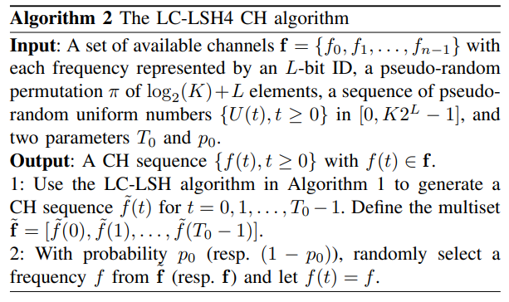
The asynchronous setting
LC-LSH4
LSH4: Dimensionality reduction
  Focal strategy
However, if there are no common channels in the multiset, two users need to rely on the random algorithm to rendezvous → The MTTR of the LC-LSH4 algorithm cannot be bounded
S. Alpern, “The rendezvous search problem,” SIAM J. Control Optim., vol. 33, pp. 673–683, 1995.
Notes:
在非同步設定下，我們用過去LSH4演算法用到的dimensionality reduction technique
提出了下面的LC-LSH4演算法
它會先用剛剛的LC-LSH演算法產生一個multiset
這裡的insight是LC-LSH演算法會透過使用global channel label，產生coupled channel hopping sequence
然後用focal strategy來加速交會時間
最後，會有p0的機率從multiset隨機挑channel，然後有1-p0的機率從available channel set隨機挑channel
但因為假如兩個人的multiset都沒有common channel的話，就只能靠random演算法來交會
所以LC-LSH4的MTTR是沒有辦法被bound住的
-
In the asynchronous setting, we use the concept of dimensionality reduction in the LSH4 algorithm. The algorithm below is the LC-LSH4 algorithm. First, we use the LC-LSH algorithm to generate a multiset. The insight here is that the LC-LSH algorithm generates coupled channel hopping sequences for the two users by utilizing global channel labels, allowing the focal strategy to be used to speed up the rendezvous process. Then, there is a probability p0​ to select a channel from the multiset and a probability 1−p0​ to select a channel from the available channel set.

Slide 18
The asym/async/hetero/ID MRP
The two users are assigned two different roles.
Their clocks may not be synchronized.
Their available channel sets may differ
Each user's channel labels are uniquely identified by an L-bit ID.
Goal: design CH sequences with a MTTR bound and a better ETTR than the random algorithm even without a global channel enumeration scheme.

Slide 19
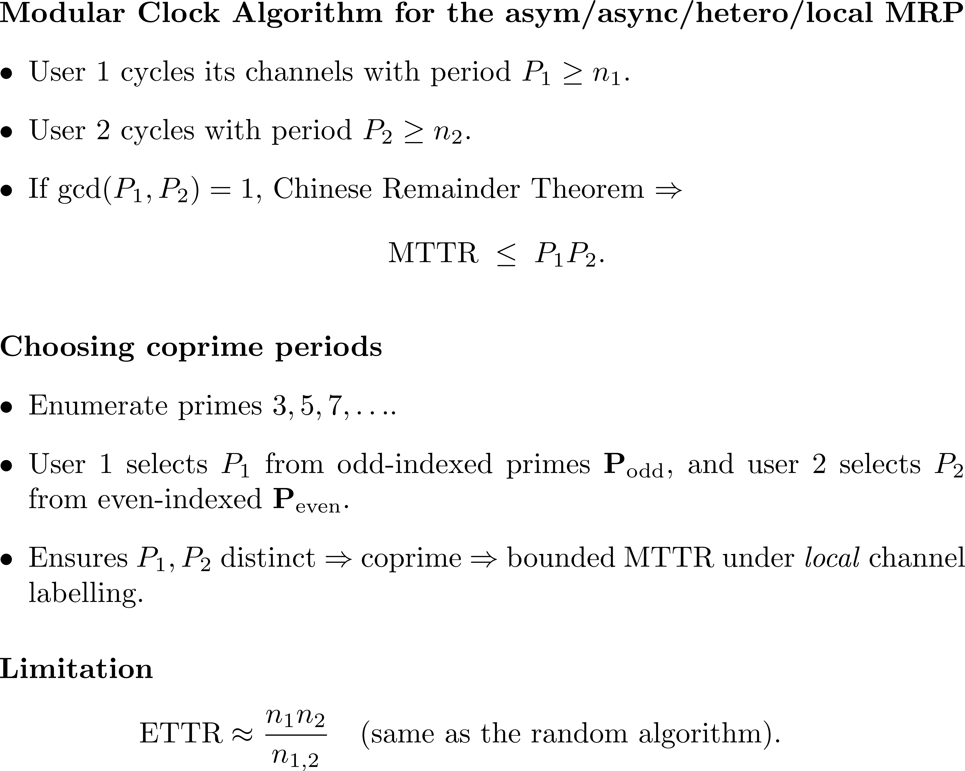
N. C. Theis, R. W. Thomas, and L. A. DaSilva, “Rendezvous for cognitive radios,” IEEE Transactions on Mobile Computing, vol. 10, no. 2, pp. 216–227, 2011.

Slide 20
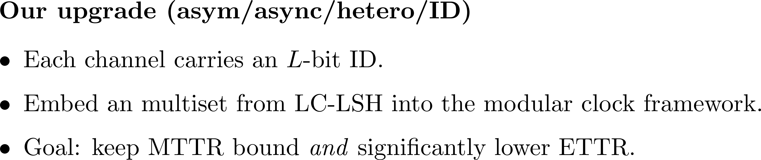
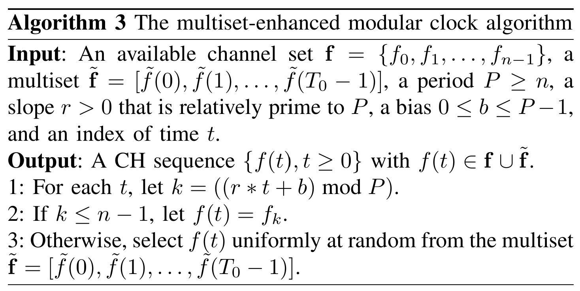
The multiset-enhanced modular clock algorithm

Slide 21
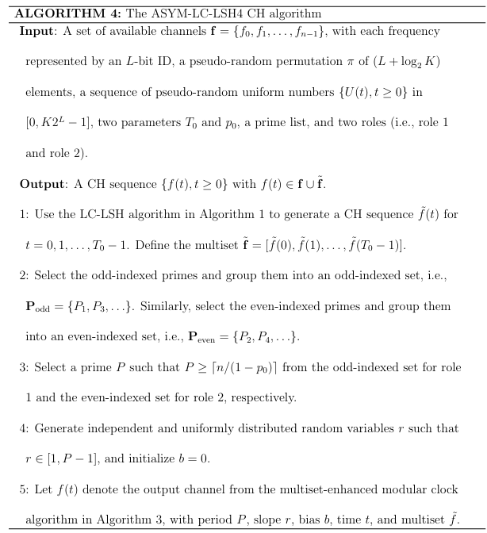
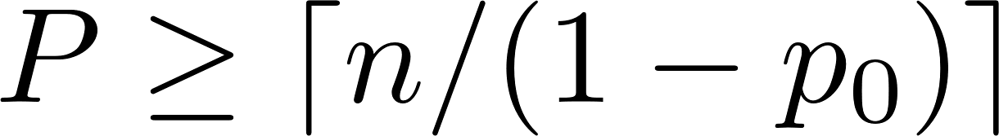
The ASYM-LC-LSH4 algorithm
Generate a multiset by LC-LSH.
The selection of a prime number:
The parameter p₀ acts as the probability to select a channel from the multiset (as in LC-LSH4).
The ETTR should be comparable to LC-LSH4.
The MTTR bound by P₁P₂
Notes:
右邊是ASY-LC-LSH4演算法
主要是先用LC-LSH產生一個multiset
然後是選質數，從剛剛提到的交會特性可以知道選的p越小越好
今天為了防止兩個人選到一樣的質數
我們會先index質數，然後根據index分成奇數set和偶數set
其中一個人從奇數set挑，另一個人就從偶數set挑
選完質數後，再把相關參數帶入multiset-enhanced modular clock演算法產生channel hopping sequence

Slide 22
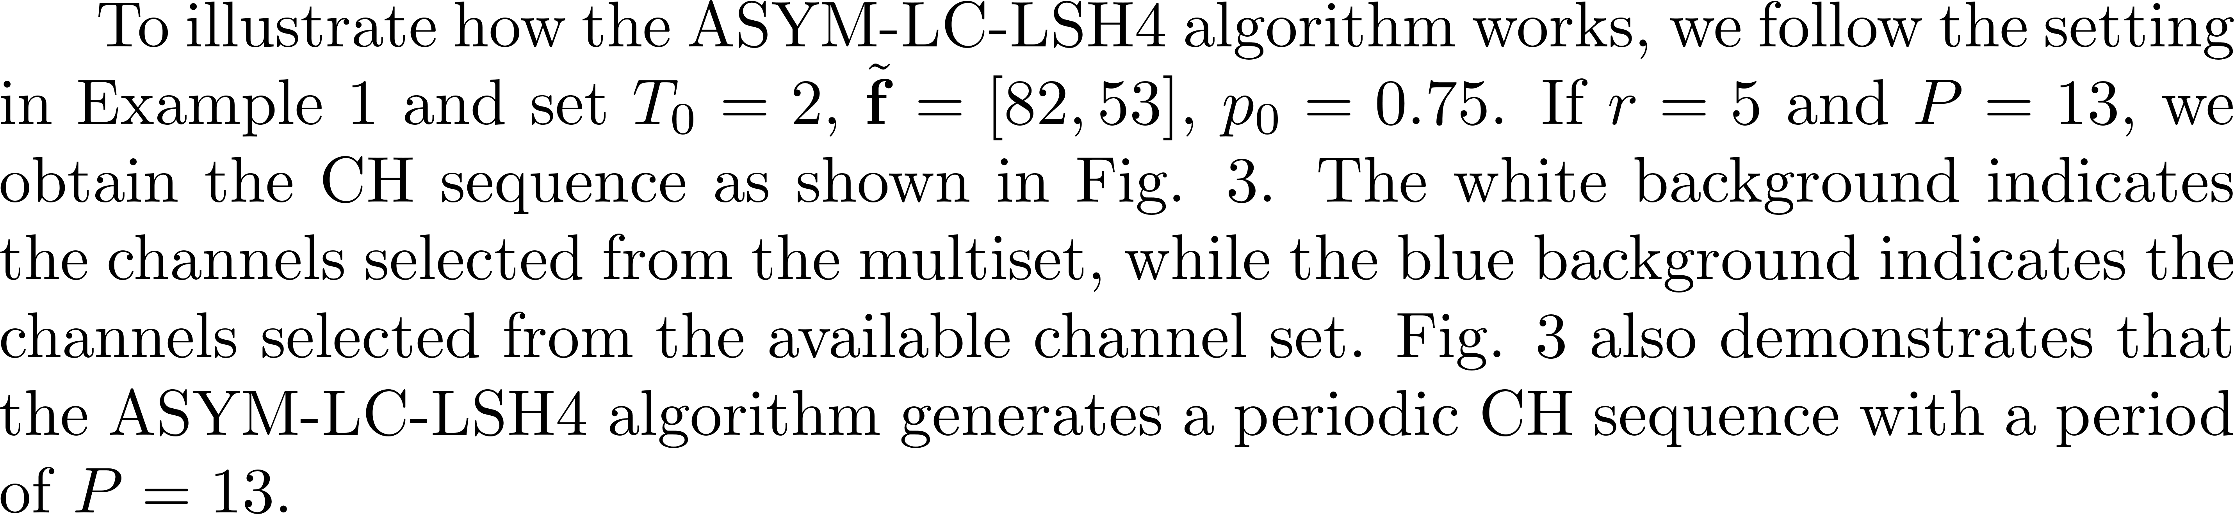
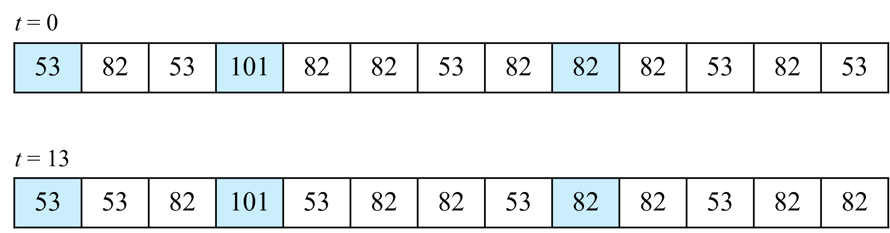
The ASYM-LC-LSH4 algorithm (3/3)
Ex:

Slide 23
The sym/async/hetero/ID MRP
The two users are indistinguishable.
Their clocks may not be synchronized.
Their available channel sets may differ
Each user's channel labels are uniquely identified by an L-bit ID.
Embedding LC-LSH4 in an (N,p)-MACH does not work as N=2³² is too large.

Slide 24
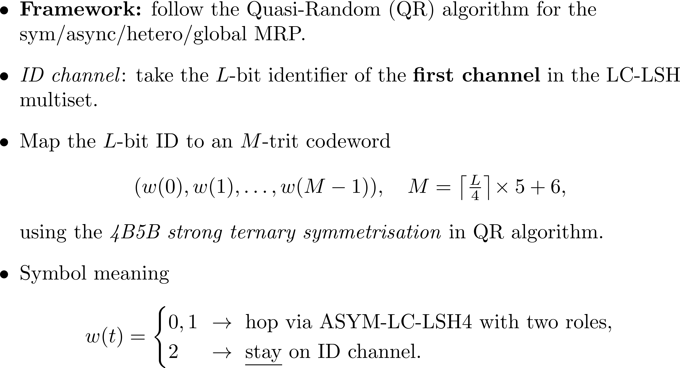
The QR-LC-LSH4 algorithm
The ETTR should be comparable to LC-LSH4.
The MTTR bound by MP₁P₂

Slide 25
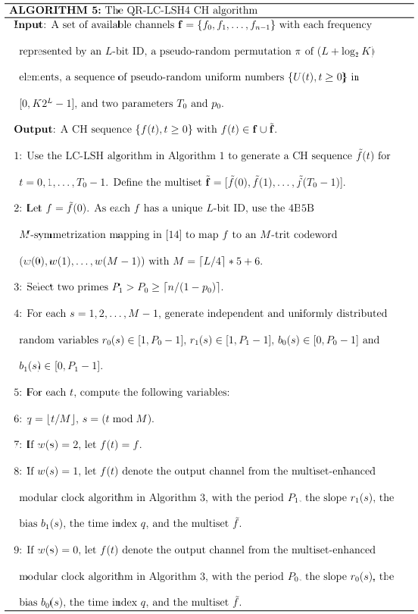
The QR-LC-LSH4 algorithm
Generate a multiset
Select an ID channel
4B5B strong ternary symmetrization mapping
Select two primes
Determine the role according to the codeword
Notes:
右邊是QR-LC-LSH4演算法
它主要也是先用LC-LSH產生一個multiset
然後會拿multiset的第一個channel做4B5B M-symmetrization mapping
接著會選擇兩個質數
最後會根據codeword決定角色
如果codeword = 2，就停留在原本的channel
如果codeword = 1 或 0，就把相關參數帶入multiset-enhanced modular clock演算法
最後產生channel hopping sequence

Slide 26
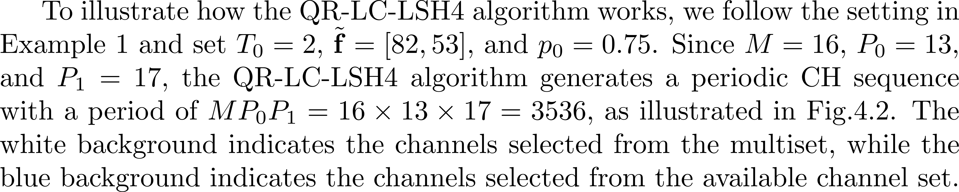
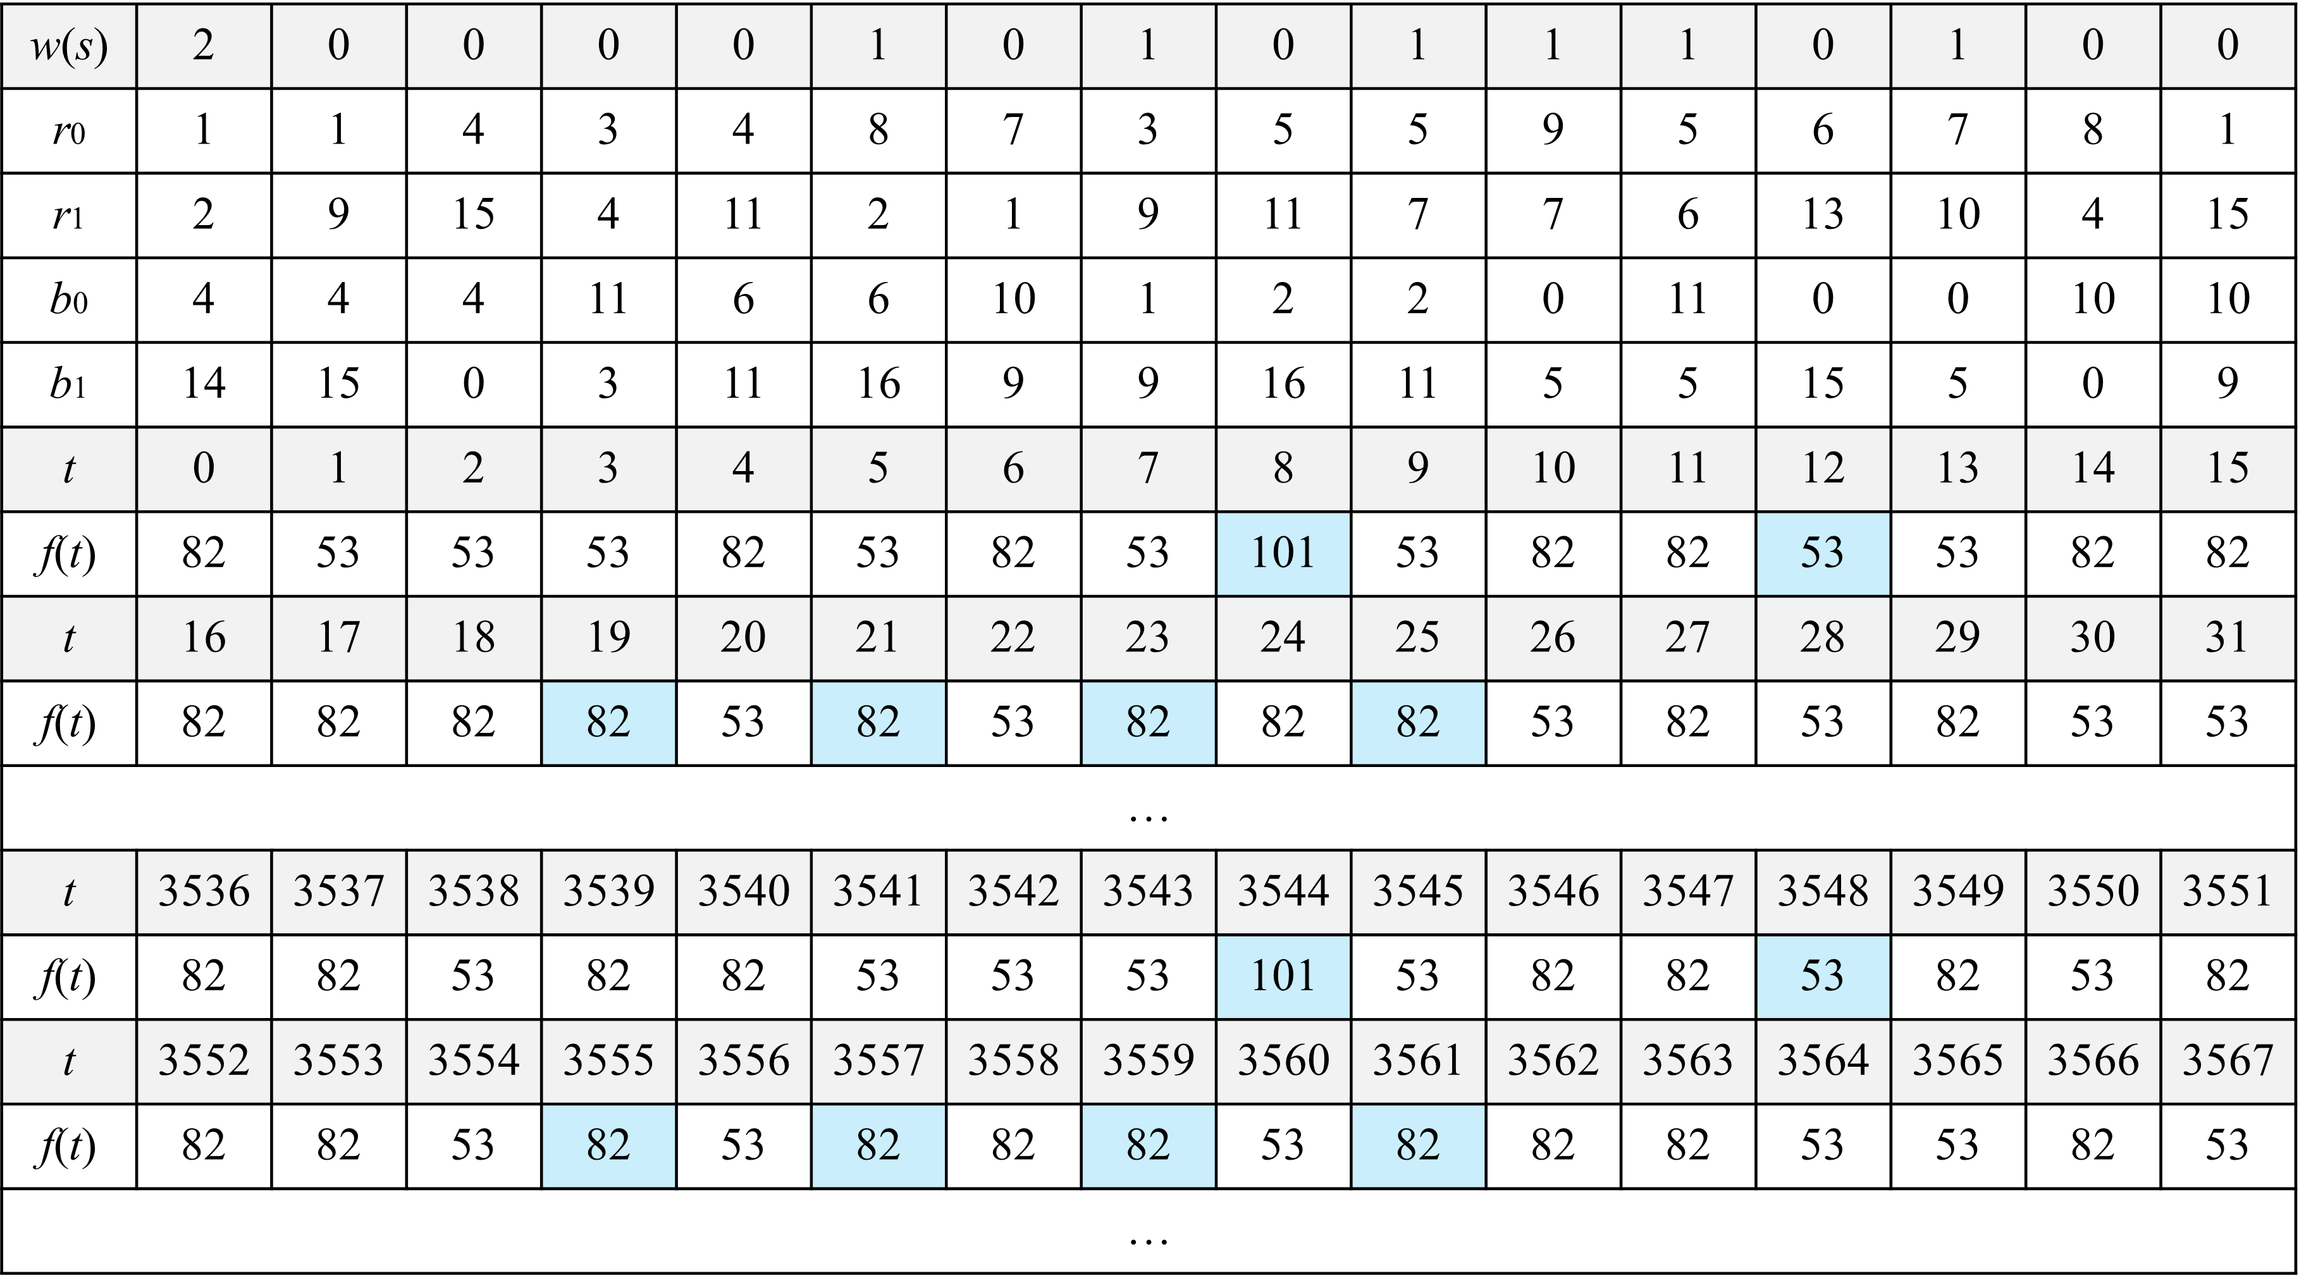
The QR-LC-LSH4 algorithm (3/3)
Ex:

Slide 27
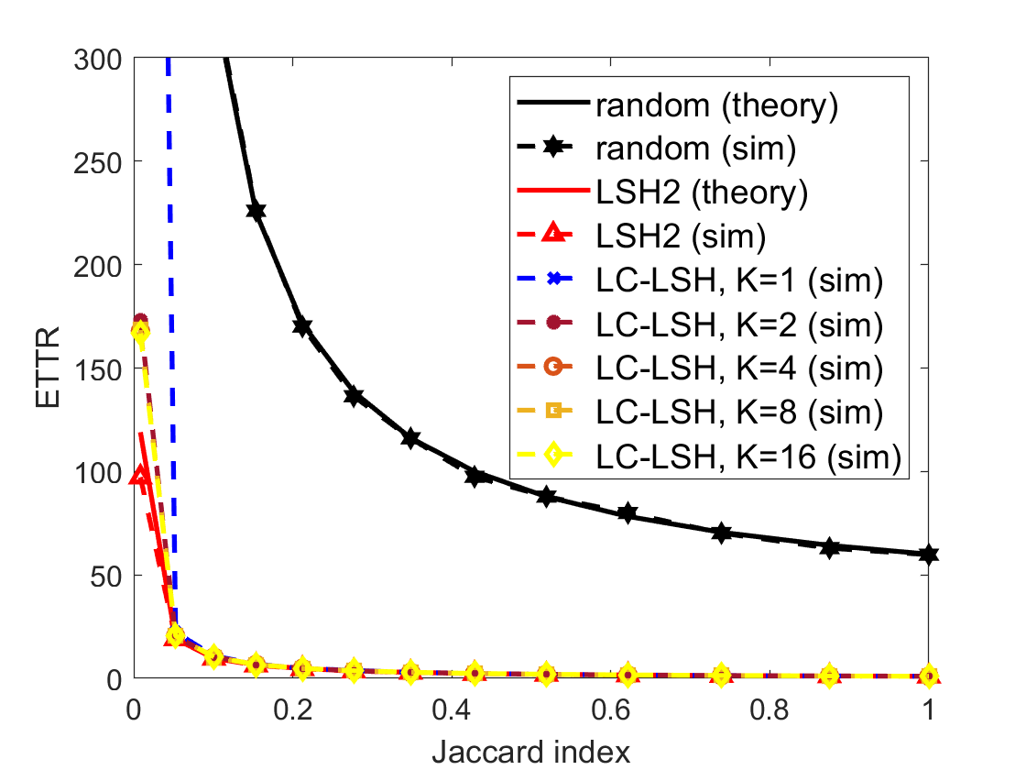
Simulation for the low-complexity algorithms
Synchronous setting
ETTR
The ETTRs are very close to the theoretical value 1/J when K ≥ 2.
Notes:
第一個先看在同步設定下，LC-LSH和其他演算法的ETTR比較
我們可以從這張圖看到當K>=2時，LC-LSH會跟LSH2有差不多的表現
而且他們都贏黑色的random很多
-
Next, I will present the simulation results of our algorithm. In the synchronous setting, the ETTRs of our LCLSH algorithm show a significant improvement compared to the random algorithm, represented by the black line, and are very close to the theoretical value 1/J, represented by the red line.

Slide 28
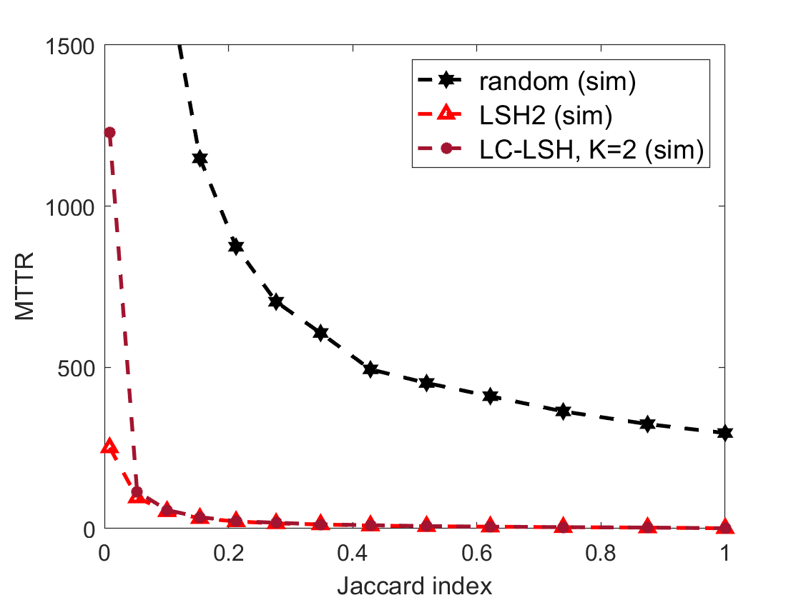
Simulation for the low-complexity algorithms
Synchronous setting
MTTR
The MTTR of our LC-LSH algorithm
cannot be bounded as it uses sampling with replacement.
Notes:
接著比較的是MTTR
可以看到因為LC-LSH是用sampling with replacement，所以MTTR沒有辦法跟LSH2一樣被bound住

Slide 29
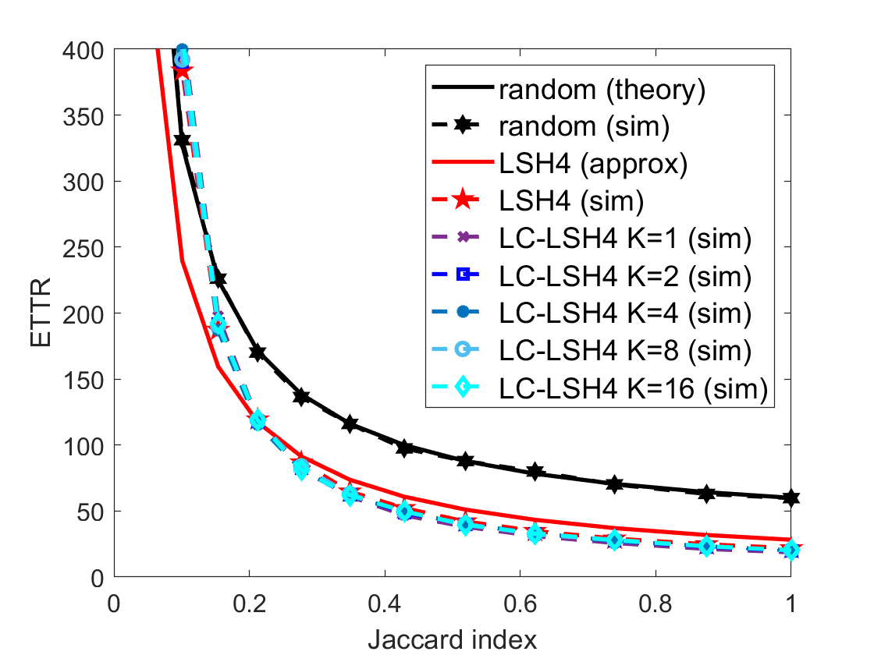
Simulation for the low-complexity algorithms
Asynchronous setting
ETTR
The ETTRs of the LC-LSH4 algorithm for various
values of K are very close to that of the LSH4 algorithm.
Notes:
然後是非同步設定下，LC-LSH4和其他演算法的ETTR比較
可以看到LC-LSH4和LSH4有差不多的表現
在J>0.2時，也和LSH4的近似值很接近
-
Then, these are the simulation results for the asynchronous setting. The ETTRs of our LC-LSH4 algorithm are very close to that of the LSH4 algorithm, represented by the red dotted line, and match well with the approximation, represented by the red solid line, when the Jaccard index is larger than 0.2.

Slide 30
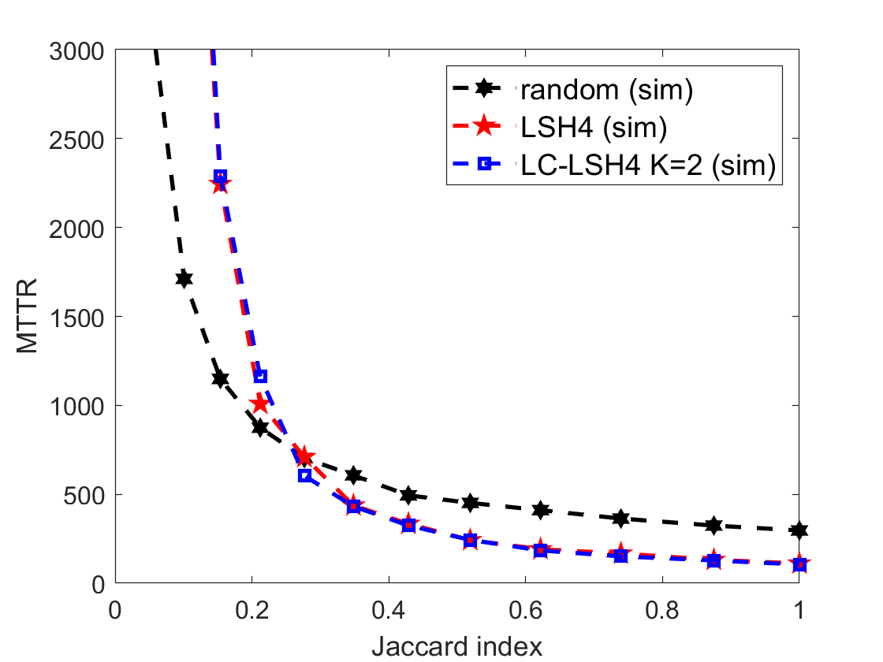
Simulation for the low-complexity algorithms
Asynchronous setting
MTTR
The MTTR of our LC-LSH4 algorithm in our simulations is similar to
that of the LSH4 algorithm.
Notes:
接著比較的是MTTR
可以看到LC-LSH4和LSH4有差不多的表現

Slide 31
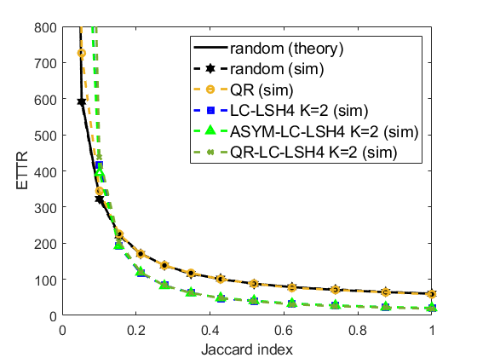
Simulation for the ASYM-LC-LSH4/QR-LC-LSH4 algorithm
Asynchronous setting
ETTR
The ETTR of the QR algorithm is comparable to that of the random algorithm.
The ETTR of our proposed ASYM-LC-LSH4 algorithm and QR-LC-LSH4 algorithm is comparable to that of the LC-LSH4 algorithm.
Notes:
接下來我們比較ASY-LC-LSH4, QR-LC-LSH4和其他演算法的ETTR
首先可以看到，跟過去的研究結果一樣，QR和random有差不多的表現
然後兩個新的演算法跟LC-LSH4有差不多的表現

Slide 32
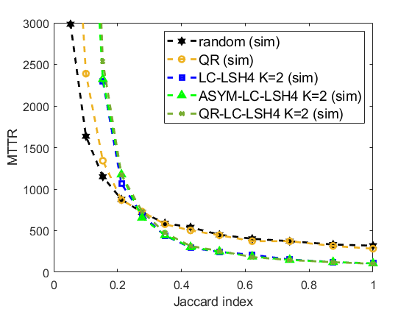
Simulation for the ASYM-LC-LSH4/QR-LC-LSH4 algorithm
Asynchronous setting
MTTR
J ≥ 0.27
The MTTR of the QR algorithm is comparable to that of the random algorithm.
The MTTR of our proposed ASYM-LC-LSH4 algorithm and the QR-LC-LSH4 algorithm is comparable to that of the LC-LSH4 algorithm.
0.27
Notes:
接著是MTTR
可以看到當J>=0.27時，QR和random有差不多的表現
兩個新的演算法跟LC-LSH4有差不多的表現
但也可以發現當J很小的時候，兩個新的演算法表現得比QR差
這些實驗結果顯示出，如果common channel很少且multiset裡沒有common channel的話，把multiset embed到modular clock不一定能夠加快交會時間
不過因為在物聯網裡兩個user之間的距離通常很近，available channel會很相似，也就是J通常會很大
所以ASY-LC-LSH4和QR-LC-LSH4在物聯網裡是適合用的

Slide 33
